Slide 1
Capstone Project Web & Social Media Analytics Presented By : KARAN K . S

Slide 2
Problem Statement
Customer is a mobile manufacturer based out of the US and has entered the
market three years ago. As they are new entrants in the sector, they want to understand their competitors and preferences of their users and design their strategies accordingly. They want to tweak the marketing strategies for adding more value to their brand, provide features to customers that add the most value and achieve operational efﬁciencies.
Objective
Objective is to provide major insights which will help in increase market share and brand value for product development, marketing and sentiment classiﬁcation engine

Slide 3
Data understanding, preparation and EDA
Step 1: Data pre-processing
Removed all the duplicate ASINs.
Removed all the rows having no review text.
Merged both ‘phonedata’ and ‘_meta_cellphonedata’ with column ‘ASIN’
Step 2: Text analytics
Extracted all the positive and negative words from the review text to make word clouds
Step 3: Building a sentiment classiﬁcation engine
Created Naive Bayes model
Area under curve for train set: 0.90
Area under curve for test set: 0.88

Slide 4
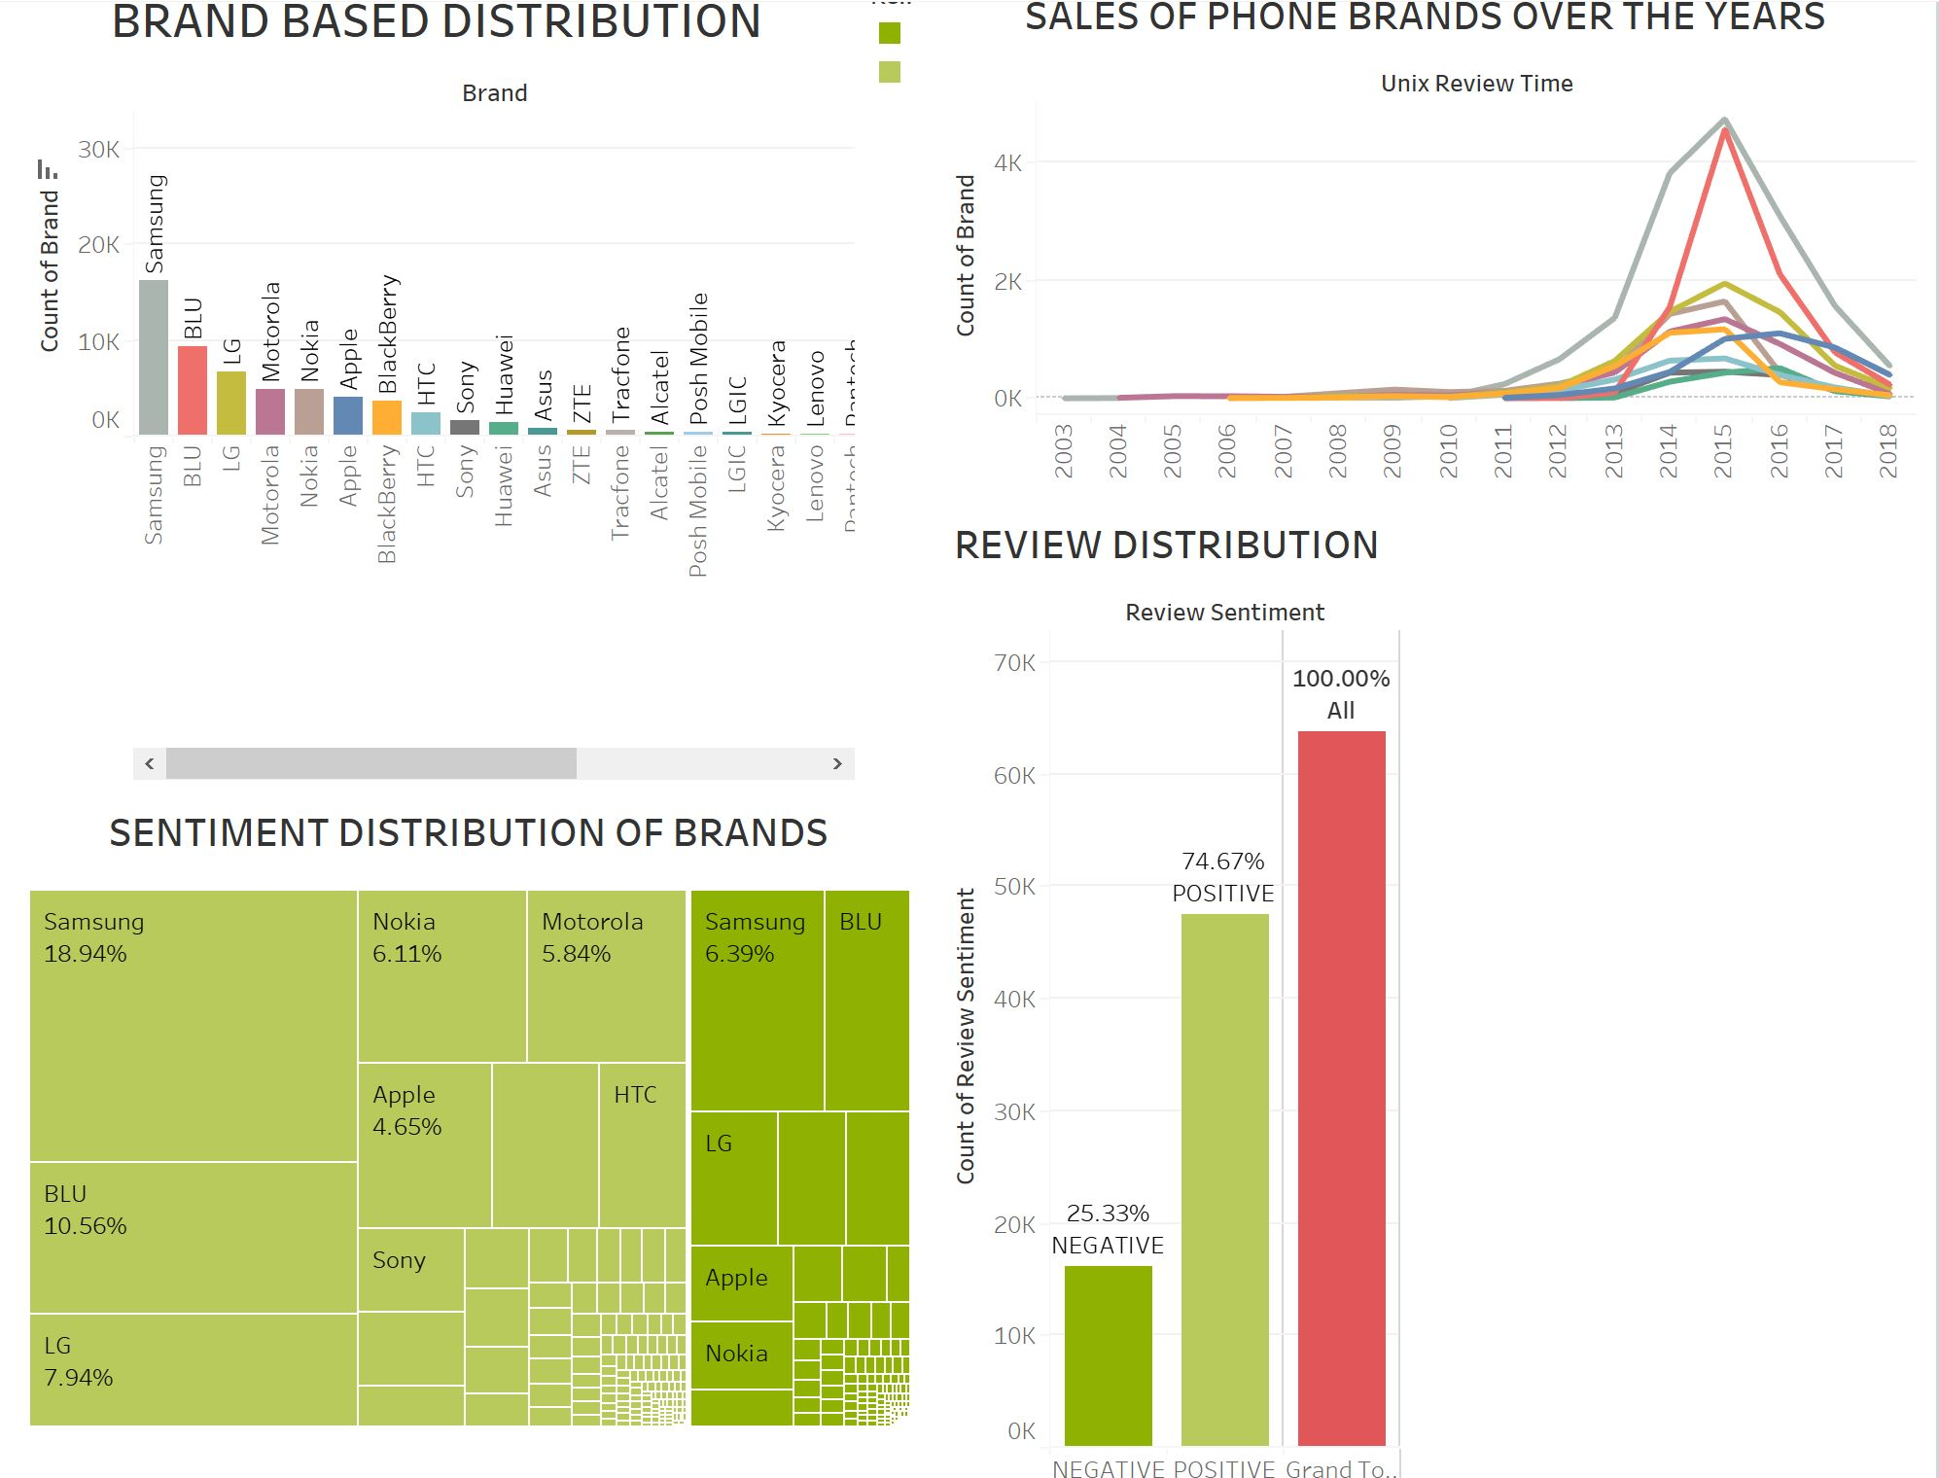
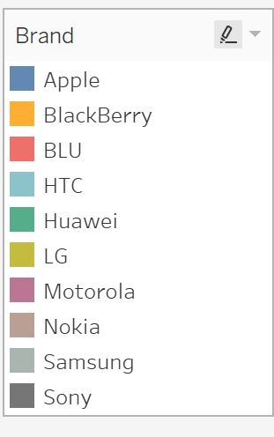
Dashboard 1

Slide 5
We observe that SAMSUNG has high brand value.
We see that SAMSUNG has highest positive review sentiment percent while APPLE has a lower negative review sentiment.
We see that SAMSUNG has highest sales – peak in 2015 followed by BLU and LG.

Slide 6
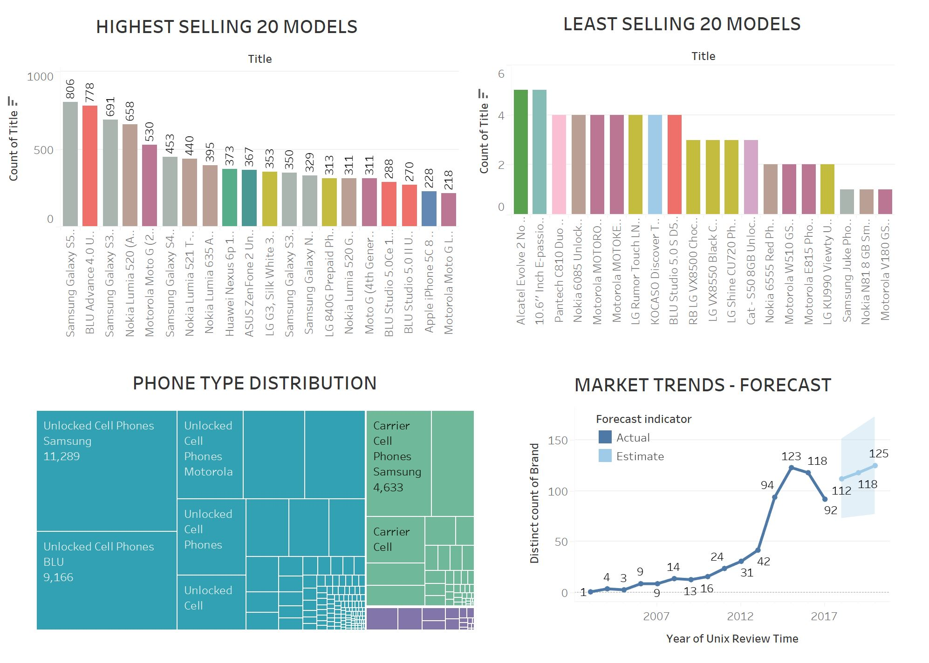
Dashboard 2

Slide 7
It is observed that SAMSUNG GALAXY S5 leads in the top 20 highest selling phones followed by BLU ADVANCE 4.0.
The least sold models are ALCATEL EVOLVE 2 and PANTECH C18 DUO.
Most number of unlocked cellphones are under SAMSUNG, BLU and MOTOROLA.

Slide 8
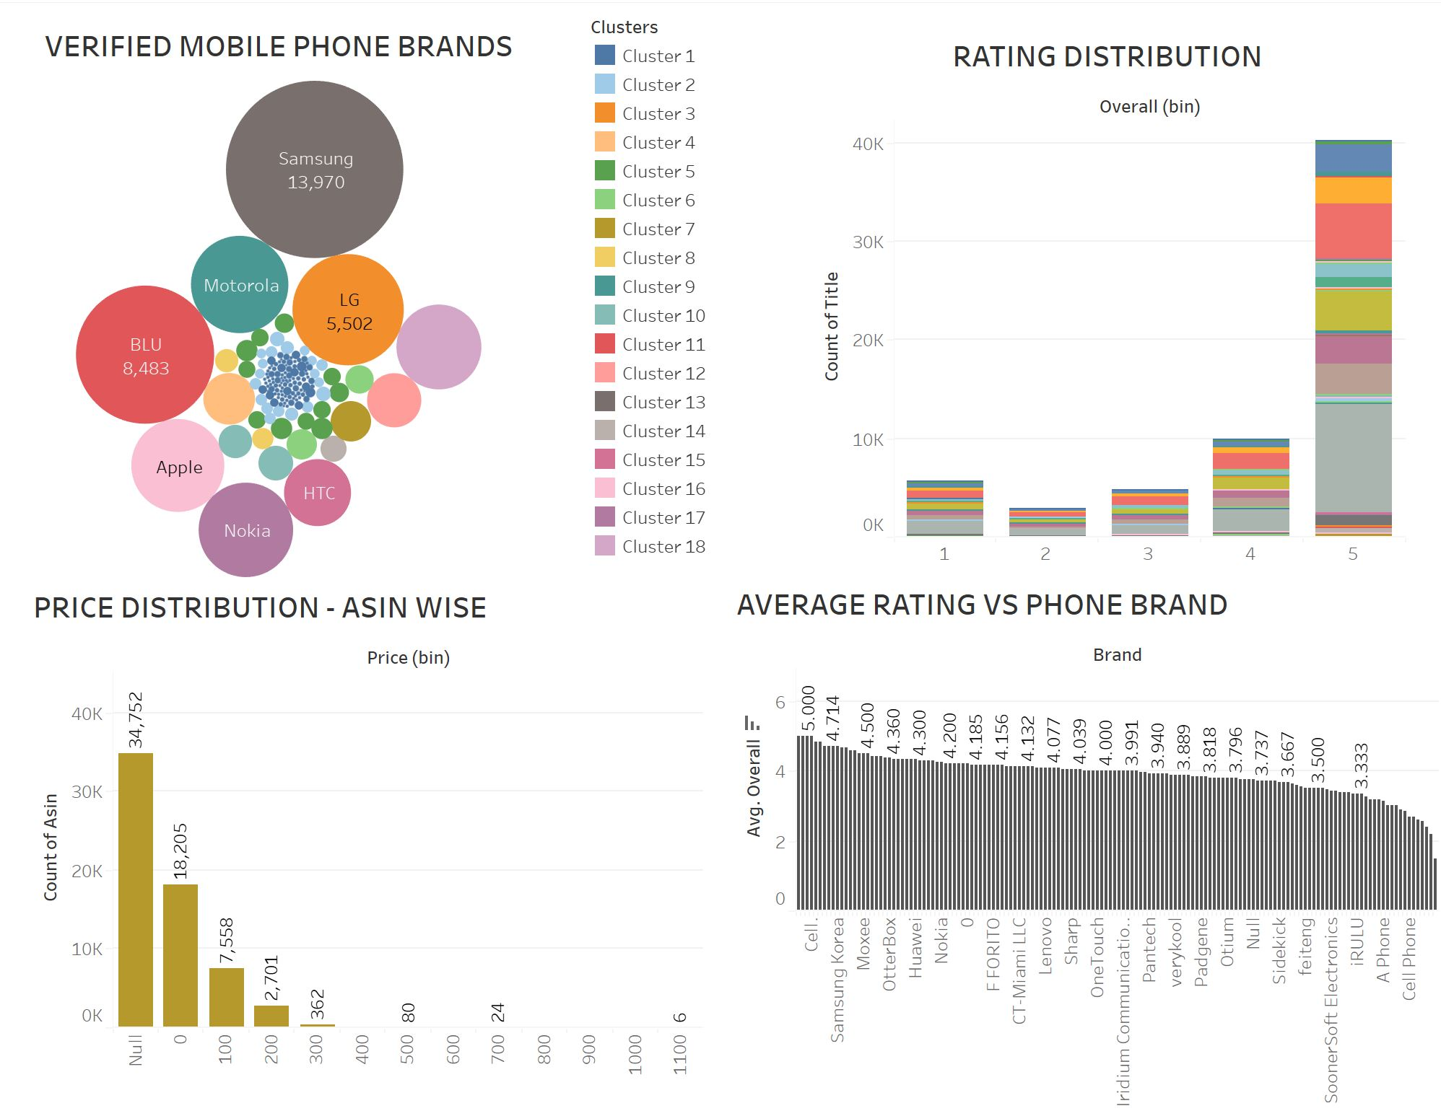
Dashboard 3

Slide 9
Top verified mobile phone brands are SAMSUNG, BLU and LG.
IGEARPRO and DISWOE have highest average rating while TRACPHONE and PEEK have the lowest.
We see that APPLE and ALCATEL have highest rating distribution among other brands.

Slide 10
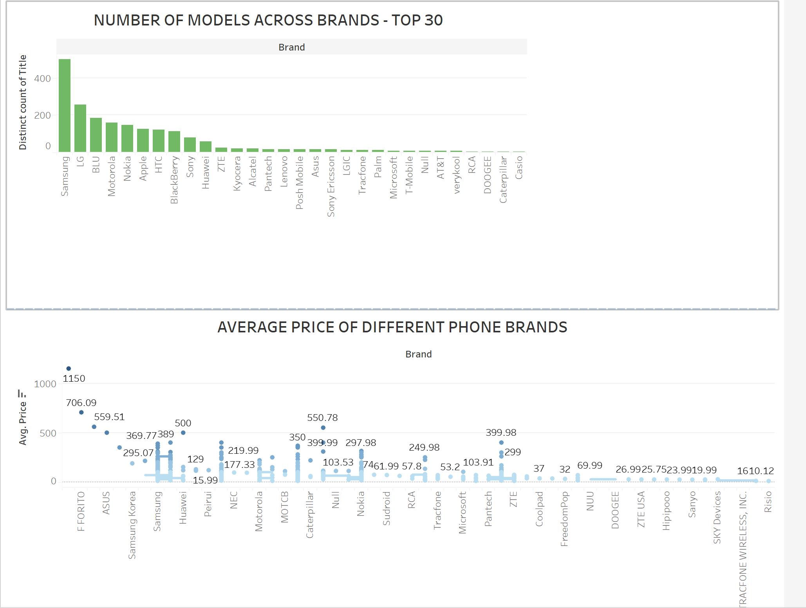
Dashboard 4

Slide 11
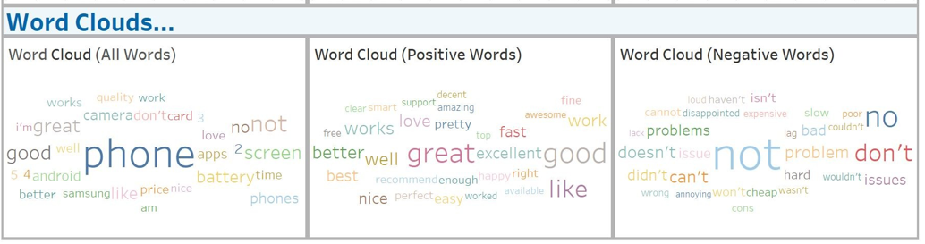
Dashboard 5

Slide 12
Insights
Samsung brand has captured 82% of market shares in mobile industry.
Top selling samsung products are as follows B00IZ1XJ3Q, B00A29WCA0 and B00N532HPK.
F FORITO ($706) stands top in average price followed by SoonerSoft ($560)
and iGearPro ($350).
Samsung (11570) has most number of reviewers followed by BLU (5759) and
LG (5410). It also indicates Samsung is the most used brand across U.S..
Samsung (68359) has received most number of reviews among all the brands. These reviews will help us in identifying custom centric values and increasing the brand value.
Samsung has most positive sentiment and BLU has most negative sentiment for ASIN models.

Slide 13
Recommendations - Features to have
The refurbishing process includes functionality testing, basic cleaning, inspection, and repackaging.
Responsive web design gives the brand a better shot at displaying its key visual components, such as feature images, logos, typography and colors. These components stimulate the emotional response of the user.
Responsive web design engenders a smooth user experience, which translates into a positive perception of the brand.
While seeking to decipher the essential attributes that should ideally be present in a Mobile phone, the ensuring trends merit careful consideration:
Communication services, such as, voice, text and pictures.
Wireless internet services, such as, browsing, corporate access and e-mail.
Distinct media services, such as , motion pictures, games and music.

Slide 14
Suggestions to increase the brand value
In order to get valuable information in the mobile reviews, sentiment analysis help brands discover the reason why customers leave some negative or positive feedback. It mines through customer's languages to uncover what customers like or dislike about a product, what their emotions are and the exact reason why they leave such feedbacks
Customer prefer lasting battery and high quality music
Trust and reliability are the key for feature phones
These are the accessories are a must-have for smartphones - Power Bank, Selﬁe sticks, USB charger, Bluetooth speaker, Screen protector, Phone cases and covers

Slide 15
Financial impact on business
Using mobile phones in business can boost productivity, mobility, safety and morale of workforce.
Improve and optimize the management, regulation and security of their ﬁnances.
Improves communication and connection.
Email and Banking become easy.
Better marketing strategies.
Food and groceries can be ordered online.
Economic Impact on the developing world.
Helps in better social networking and increases availability to the clients.

Slide 16
Thanks!

